Slide 1
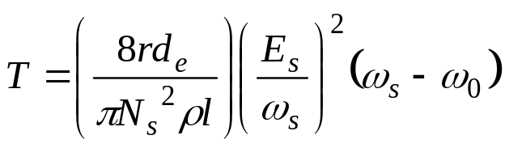
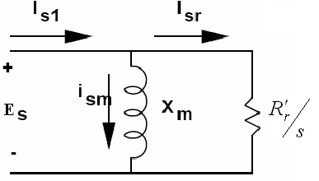
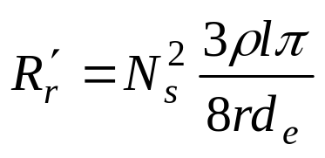
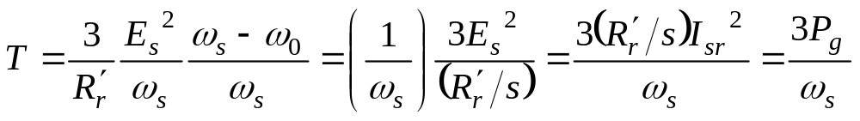
Induction Machines
OPERATION NEAR SYNCHRONOUS SPEED
Now we can find torque in terms of the equivalent circuit parameters:
Here P_{g} is the power transferred to the resistance R’_{r}/s through the airgap.

Slide 2
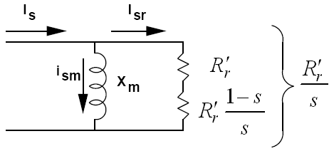
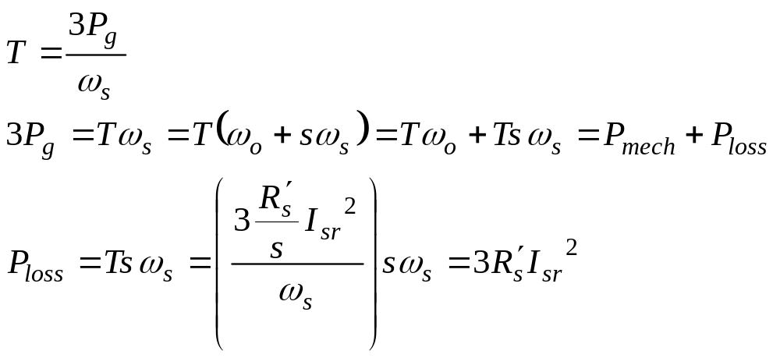
Induction Machines
OPERATION NEAR SYNCHRONOUS SPEED
Of this power a portion is converted to mechanical power represented by power dissipated in resistance R’r (1-s)/s and the remaining is losses in the rotor resistance, represented by the losses on resistance R’_{r}.

Slide 3
Induction Machines
LEAKAGE INDUCTANCES AND THEIR EFFECTS
In the previous discussion we assumed that all the flux crosses the airgap and links both the stator and rotor windings. In addition to this flux there are flux components which link only the stator or
the rotor windings and are proportional to the currents there, producing voltages in these windings.
This is simple to model for the stator windings, since the equivalent circuit we are using is of the stator, and we can model the effects of this flux with only an inductance. The rotor leakage flux can be modeled in the rotor circuit, as well, but corresponding to frequency of the frequency of the rotor currents: ω_{s}-ω_{o} .

Slide 4
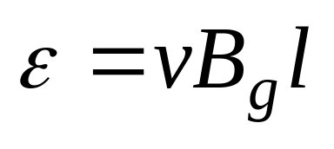
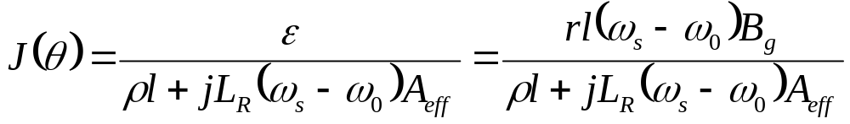
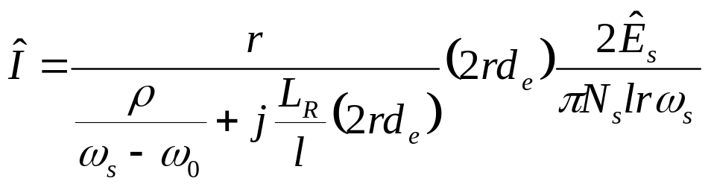
Induction Machines
LEAKAGE INDUCTANCES AND THEIR EFFECTS
Assume that the rotor the rotor has a leakage inductance of L_{R}:
Induced voltage in the bars :
Then the current density J (θ) will be:
And the peak rotor current is:

Slide 5
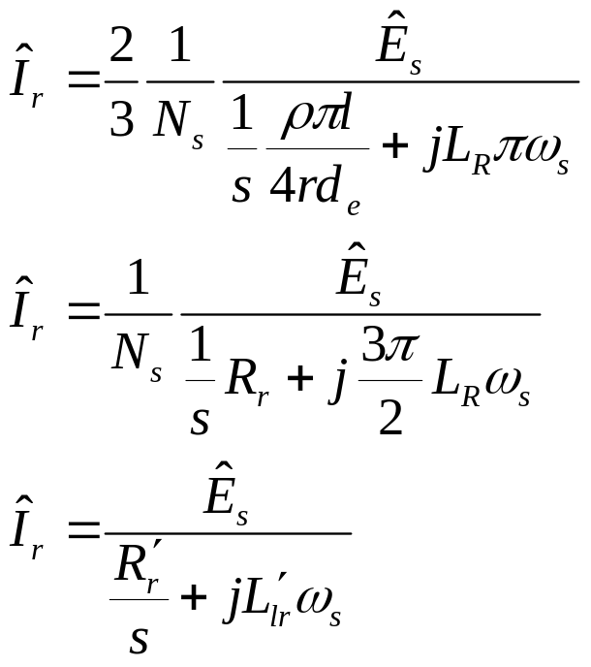
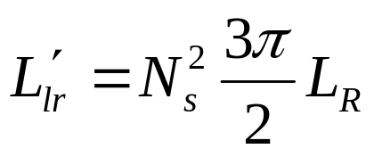
Induction Machines
LEAKAGE INDUCTANCES AND THEIR EFFECTS
So the peak per-phase rotor current is:
Where:

Slide 6
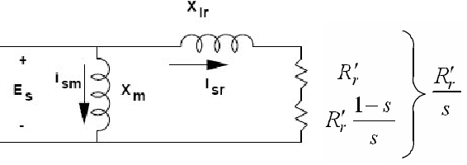
Induction Machines
LEAKAGE INDUCTANCES AND THEIR EFFECTS
Note that this equation only depends on ω_{s}. Hence we can model the complete rotor circuit in stator side as below:

Slide 7
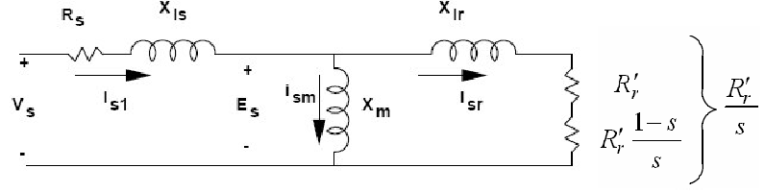
Induction Machines
LEAKAGE INDUCTANCES AND THEIR EFFECTS
Adding the leakage reactance of stator and the resistance of stator winding, we will find the equivalent circuit of induction machine. Note that this circuit is valid for all speeds (not only when the machine operates near synchronous speed).

